Slide 1

Angular Fundamentals
Anup Vasudeva

Slide 2
Agenda
Session 1
Session 2
Setup
Multi Page Vs Single Page App
Packaged HTML, CSS and JS: Web Components
Pillars of Angular
TS modules vs Angular modules
App walkthrough
Components (with property bindings and event bindings)
Built-in directives
Built-in and custom pipes
Custom Directives
Routing
Forms
Services

Slide 3
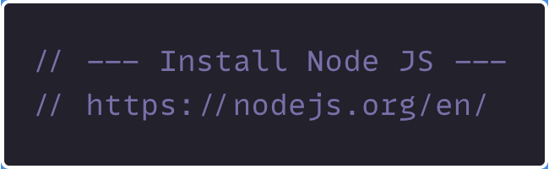
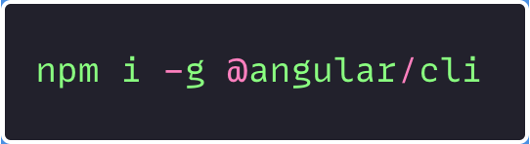
Setup
1
2
3
https://github.com/innovation-stack/ng-freshers-11th-Jan-2021

Slide 4
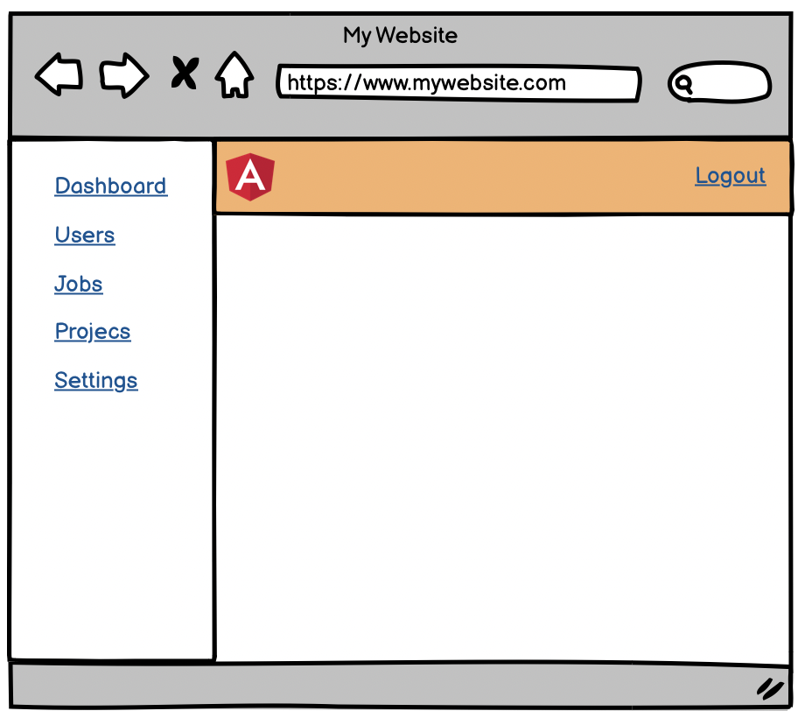
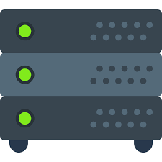
Multi Page App (MPA)
Browser
Server
1
User requests mywebsite.com
2
Server constructs the complete HTML (header, sidebar, content area)
3
User clicks on Dashboard link. Request for /dashboard is sent to server by reloading the complete page. Current DOM is destroyed
4
Server constructs a new HTML page (header, sidebar, content area) for dashboard
Reconstructs DOM on every single request
On subsequent requests, it leverages the same assets if they are already cached
Bad user experience
Handles routing infrastructure
Combines markup and code via templating language
Good for SEO

Slide 5
Single Page App (SPA)
Browser
Server
1
User requests mywebsite.com/
2
Server return a shell (container) page, with bare minimum markup and related JS files
3
Based on the request (routing), client constructs the layout
4
User clicks on Dashboard link. Browser renders dashboard layout. It fetches the data via API exposed by server. No page reload.
Handles routing infrastructure via JavaScript
Combines markup and code via templating language
On subsequent requests, it leverages the same assets if they are already cached
No full page reload. Great user experience
Contains the static assets (HTML, CSS, JS, images)
Exposes API
Google can index JS driven web pages. Other search engines, like Bing does not.
Angular Universal – Server-side rendering

Slide 6
Packaged HTML, CSS and JS: Web Components
Create custom HTML tags, attributes and events
Web Components Basics: https://developer.mozilla.org/en-US/docs/Web/Web_Components
Angular supports creating Web Components (via Angular Elements)

Slide 7
Pillars of Angular
Components
Contains template, data and logic to construct DOM
Can construct nested components – tree of components
Directives
Attach behavior, extend or transform a particular element/its children
Services
Business logic (HTTP requests)
Module
Building blocks that contains routes, components, pipes, services
Not a TypeScript module
Routing
Renders component based on URL

Slide 8
TS modules vs Angular modules
TypeScript Module
Enables code modularity
Angular is divided into TypeScript modules:
@angular/core
@angular/router
@angular/forms
@angular/common/http
Angular Module
Container/Namespace to register related components, pipes, filters, directives and services
Root Module + Feature Modules + Shared Modules

Slide 9
THANK YOU!!!

